Slide 1
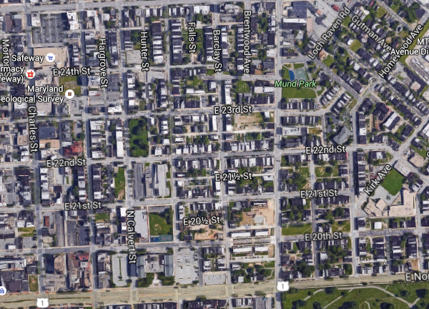
F(crime)
Shayna Rose
Data Science, Cohort 9
General Assembly

